Slide 1
DMS 201 : Introduction to Management Module-II: Financial Management Dr. Parvati Neelakantan

Slide 2
PART 1: BUSINESS ENVIRONMENT Lecture 5: Measuring the cost of living

Slide 3
In this class, look for the answers to these questions:
What is the Consumer Price Index (CPI)? How is it calculated? What’s it used for?
What are the problems with the CPI? How serious are they?
How does the CPI differ from the GDP deflator?
How can we use the CPI to compare Rs amounts from different years? Why would we want to do this, anyway?
How can we correct interest rates for inflation?

Slide 4
The Consumer Price Index (CPI) and Inflation
0
measures the typical consumer’s cost of living.
a measure of the overall cost of the goods and services bought by a typical consumer.
The consumer price index (CPI) shows the cost of a basket of goods and services relative to the cost of the same basket in the base year. The base year is the benchmark against which other years are compared.
The index is used to measure the overall level of prices in the economy.
The percentage change in the consumer price index measures the inflation rate.
Inflation does not mean that the prices of all goods in the economy are rising. Inflation means that prices on average are rising. In fact, the prices of many electronic goods (such as computers) have fallen over time.
Notes:
4

Slide 5
How the CPI Is Calculated
0
Fix the “basket.” The National Statistical Office (NSO), Ministry of Statistics and Programme Implementation (MoSPI) surveys consumers to determine what’s in the typical consumer’s “shopping basket.”
Find the prices. It collects data on the prices of all the goods in the basket.
Compute the basket’s cost. Use the prices to compute the total cost of the basket.
Notes:
5

Slide 6
How the CPI Is Calculated
0
Choose a base year and compute the index. The CPI in any year equals
100 x
cost of basket in current year
cost of basket in base year
Compute the inflation rate. The percentage change in the CPI from the preceding period.
Inflation rate
CPI this year – CPI last year
=
x 100%
CPI last year
Notes:
6

Slide 7
EXAMPLE
0
basket: {4 pizzas, 10 lattes}
year
price of pizza
price of latte
cost of basket
2010
$10
$2.00
$10 x 4 + $2 x 10 = $60
2011
$11
$2.50
$11 x 4 + $2.5 x 10 = $69
2012
$12
$3.00
$12 x 4 + $3 x 10 = $78
using 2010 base year:
Compute CPI in each year
2010: 100 x ($60/$60) = 100
2011: 100 x ($69/$60) = 115
2012: 100 x ($78/$60) = 130
Inflation rate:
115 – 100
15%
=
x 100%
100
130 – 115
13%
=
x 100%
115
Notes:
7

Slide 8
ACTIVE LEARNING ₁ Calculate the CPI
 | price of wheat | price of rice
2010 | $4 | $4
2011 | $5 | $5
2012 | $9 | $6
CPI basket: {10 Kgs wheat, 20 Kgs rice}
The CPI basket cost $120 in 2010, the base year.
A. Compute the CPI in 2011.
B. What was the CPI inflation rate from 2011–2012?

Slide 9
ACTIVE LEARNING ₁ Answers
 | price of wheat | price of rice
2010 | $4 | $4
2011 | $5 | $5
2012 | $9 | $6
CPI basket: {10 Kgs wheat, 20 Kgs rice}
The CPI basket cost $120 in 2010, the base year.
A. Compute the CPI in 2011:
Cost of CPI basket in 2011 = ($5 x 10) + ($5 x 20) = $150
CPI in 2011 = 100 x ($150/$120) = 125

Slide 10
ACTIVE LEARNING ₁ Answers
 | price of wheat | price of rice
2010 | $4 | $4
2011 | $5 | $5
2012 | $9 | $6
CPI basket: {10 Kgs wheat, 20 Kgs rice}
The CPI basket cost $120 in 2010, the base year.
B. What was the inflation rate from 2011–2012?
Cost of CPI basket in 2012 = ($9 x 10) + ($6 x 20) = $210
CPI in 2012 = 100 x ($210/$120) = 175
CPI inflation rate = (175 – 125)/125 = 40%

Slide 11
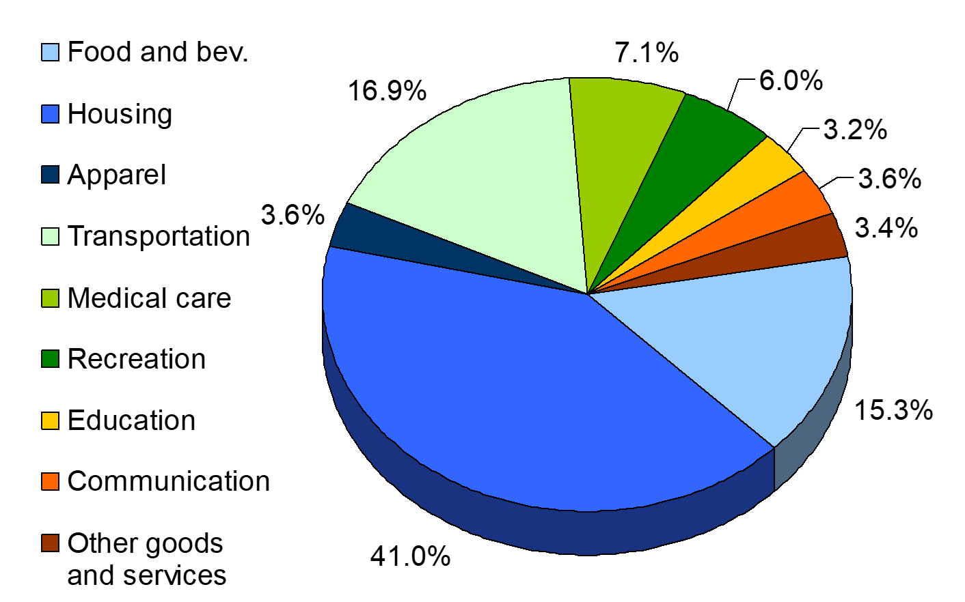
What’s in the CPI’s Basket?
Figure shows the makeup of the market basket used to compute the CPI.

Slide 12
ACTIVE LEARNING ₂ Substitution bias
CPI basket: {10# wheat, 20# rice}
In 2010 and 2011, households bought CPI basket.
In 2012, households bought {5 Kgs wheat, 25 Kgs rice}.
 | wheat | rice | cost of CPI basket
2010 | $4 | $4 | $120
2011 | $5 | $5 | $150
2012 | $9 | $6 | $210
A. Compute cost of the 2012 household basket.
B. Compute % increase in cost of household basket over 2011–12, compare to CPI inflation rate.

Slide 13
ACTIVE LEARNING ₂ Answers
CPI basket: {10# wheat, 20# rice}
Household basket in 2012: {5# wheat, 25# rice}
 | wheat | rice | cost of CPI basket
2010 | $4 | $4 | $120
2011 | $5 | $5 | $150
2012 | $9 | $6 | $210
A. Compute cost of the 2012 household basket.
($9 x 5) + ($6 x 25) = $195

Slide 14
ACTIVE LEARNING ₂ Answers
CPI basket: {10# wheat, 20# rice}
Household basket in 2012: {5# wheat, 25# rice}
 | wheat | rice | cost of CPI basket
2010 | $4 | $4 | $120
2011 | $5 | $5 | $150
2012 | $9 | $6 | $210
B. Compute % increase in cost of household basket over 2011–12, compare to CPI inflation rate.
Rate of increase: ($195 – $150)/$150 = 30%
CPI inflation rate from previous problem = 40%

Slide 15
Problems with the CPI: Substitution Bias
0
Over time, some prices rise faster than others.
Consumers substitute toward goods that become relatively cheaper, mitigating the effects of price increases.
The CPI misses this substitution because it uses a fixed basket of goods.
Thus, the CPI overstates increases in the cost of living.
Notes:
15

Slide 16
Problems with the CPI: Introduction of New Goods
0
The introduction of new goods increases variety, allows consumers to find products that more closely meet their needs.
In effect, Rs become more valuable.
The CPI misses this effect because it uses a fixed basket of goods.
Thus, the CPI overstates increases in the cost of living.
Notes:
16

Slide 17
Problems with the CPI: Unmeasured Quality Change
0
Improvements in the quality of goods in the basket increase the value of each rupee.
The NSO tries to account for quality changes but probably misses some, as quality is hard to measure.
Thus, the CPI overstates increases in the cost of living.
Notes:
17

Slide 18
Problems with the CPI
0
Each of these problems causes the CPI to overstate cost of living increases.
The NSO has made technical adjustments, but the CPI probably still overstates inflation by about 0.5-1 percent per year.
Notes:
18

Slide 19
ACTIVE LEARNING ₃ CPI vs. GDP deflator
In each scenario, determine the effects on the CPI and the GDP deflator.
A. Starbucks raises the price of Frappuccinos.
B. A local manufacturer raises the price on industrial tractors it produces.
C. Armani raises the price of the jeans it sells in India.

Slide 20
ACTIVE LEARNING ₃ Answers
A. Starbucks raises the price of Frappuccinos.
The CPI and GDP deflator both rise.
B. A local manufacturer raises the price on industrial tractors it produces.
The GDP deflator rises, the CPI does not.
C. Armani raises the price of the jeans it sells in India.
The CPI rises, the GDP deflator does not.

Slide 21
Contrasting the CPI and GDP Deflator
0
The GDP deflator reflects the prices of all goods produced domestically, while the CPI reflects the prices of all goods bought by consumers.
Imported consumer goods:
included in CPI
excluded from GDP deflator
Capital goods:
excluded from CPI
included in GDP deflator (if produced domestically)
The basket:
CPI uses fixed basket
GDP deflator uses basket of currently produced goods & services
This matters if different prices are changing by different amounts.
Notes:
21

Slide 22
Correcting Variables for Inflation: Comparing Rupee Figures from Different Times
0
Inflation makes it harder to compare rupee amounts from different times.
Example: Suppose the minimum wage
Rs 1.15 in Dec 1964
Rs 7.25 in Dec 2010
Did min wage have more purchasing power in Dec 1964 or Dec 2010?
To compare, use CPI to convert 1964 figure into “2010 Rs”…
Notes:
22

Slide 23
Correcting Variables for Inflation: Comparing Dollar Figures from Different Times
0
Amount in today’s Rs
Amount in year T Rs
Price level today
=
x
Price level in year T
0
In our example,
“year T” is 12/1964, “today” is 12/2010
Min wage was Rs 1.15 in year T
CPI = 31.3 in year T, CPI = 220.3 today
The minimum wage in 1964 was Rs8.09 in 2010 Rs.
220.3
Rs8.09
=
Rs1.15
x
31.3
Note: the ratio of price levels = 220.3/31.3 = 7.04. This means that the cost of living has increased by a factor of 7.04. The Rs1.15 minimum wage in December 1964 could have purchased $8.09 worth of goods and services if prices in 1964 equaled their December 2010 levels.
Notes:
23

Slide 24
Correcting Variables for Inflation: Comparing Dollar Figures from Different Times
0
Researchers, business analysts, and policymakers often use this technique to convert a time series of current-Rs (nominal) figures into constant-Rs (real) figures.
They can then see how a variable has changed over time after correcting for inflation.
Example: the minimum wage…
Notes:
24

Slide 25
Correcting Variables for Inflation: Real vs. Nominal Interest Rates
Example: Sai Saver deposits Rs 1,000 into a bank account that pays an annual interest rate
of 10%. A year later, he withdraws Rs 1,100.
What matters to Sai is the purchasing power of his money.
a. If there is zero inflation, his purchasing power has risen by 10%.
b. If there is 6% inflation, his purchasing power has risen by about 4%.
c. If there is 10% inflation, his purchasing power has remained the same.
d. If there is 12% inflation, his purchasing power has declined by about 2%.
e. If there is 2% deflation, his purchasing power has risen by about 12%.

Slide 26
Correcting Variables for Inflation: Real vs. Nominal Interest Rates
0
The nominal interest rate:
the interest rate not corrected for inflation
the rate of growth in the dollar value of a deposit or debt
The real interest rate:
corrected for inflation
the rate of growth in the purchasing power of a deposit or debt
Real interest rate = (nominal interest rate) – (inflation rate)
Notes:
26

Slide 27
Correcting Variables for Inflation: Real vs. Nominal Interest Rates
0
Example:
Deposit Rs1,000 for one year.
Nominal interest rate is 9%.
During that year, inflation is 3.5%.
Real interest rate = Nominal interest rate – Inflation
= 9.0% – 3.5% = 5.5%
The purchasing power of the Rs1000 deposit has grown 5.5%.
Notes:
27
31

Slide 28
SUMMARY
The Consumer Price Index is a measure of the cost of living. The CPI tracks the cost of the typical consumer’s “basket” of goods & services.
The CPI is used to make Cost of Living Adjustments and to correct economic variables for the effects of inflation.
The real interest rate is corrected for inflation and is computed by subtracting the inflation rate from the nominal interest rate.

